Slide 1

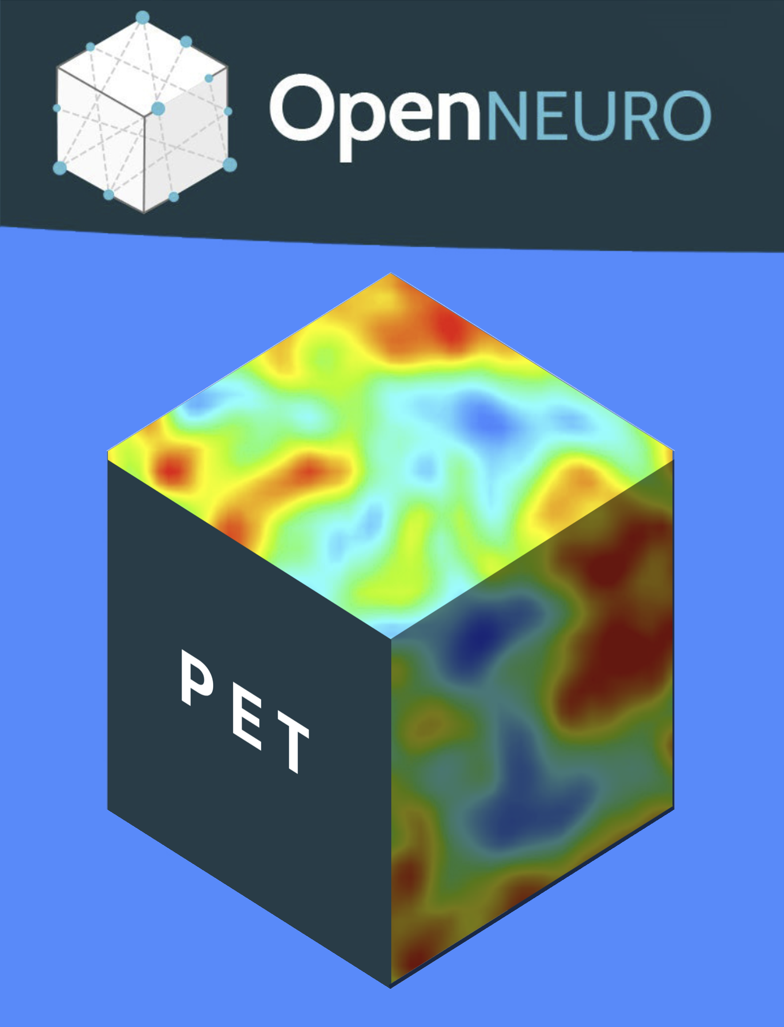
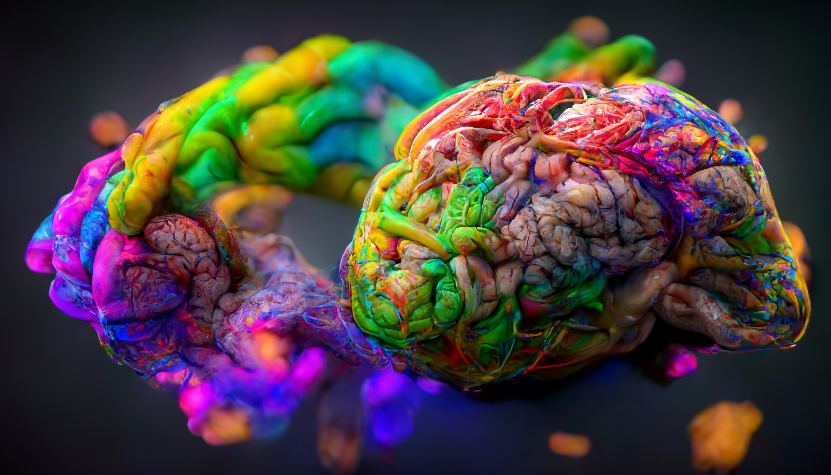
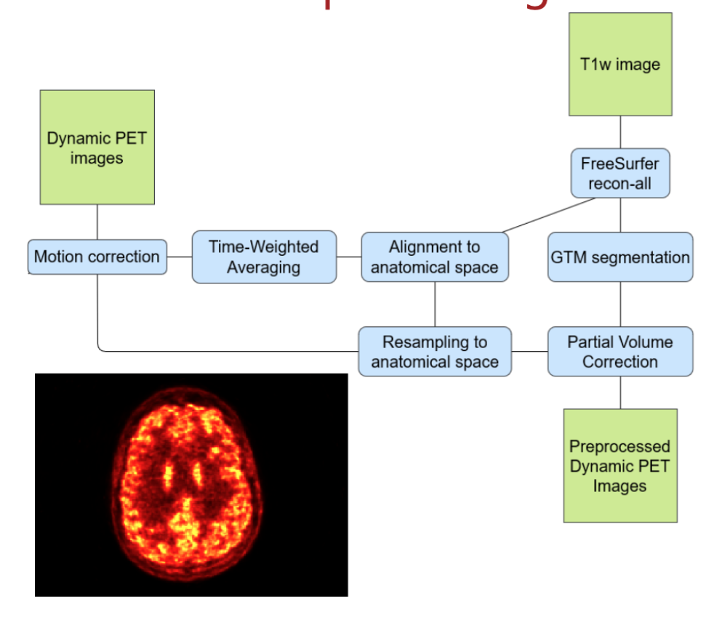
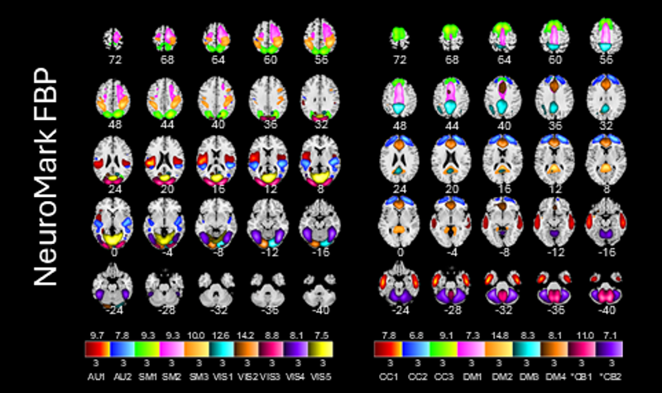
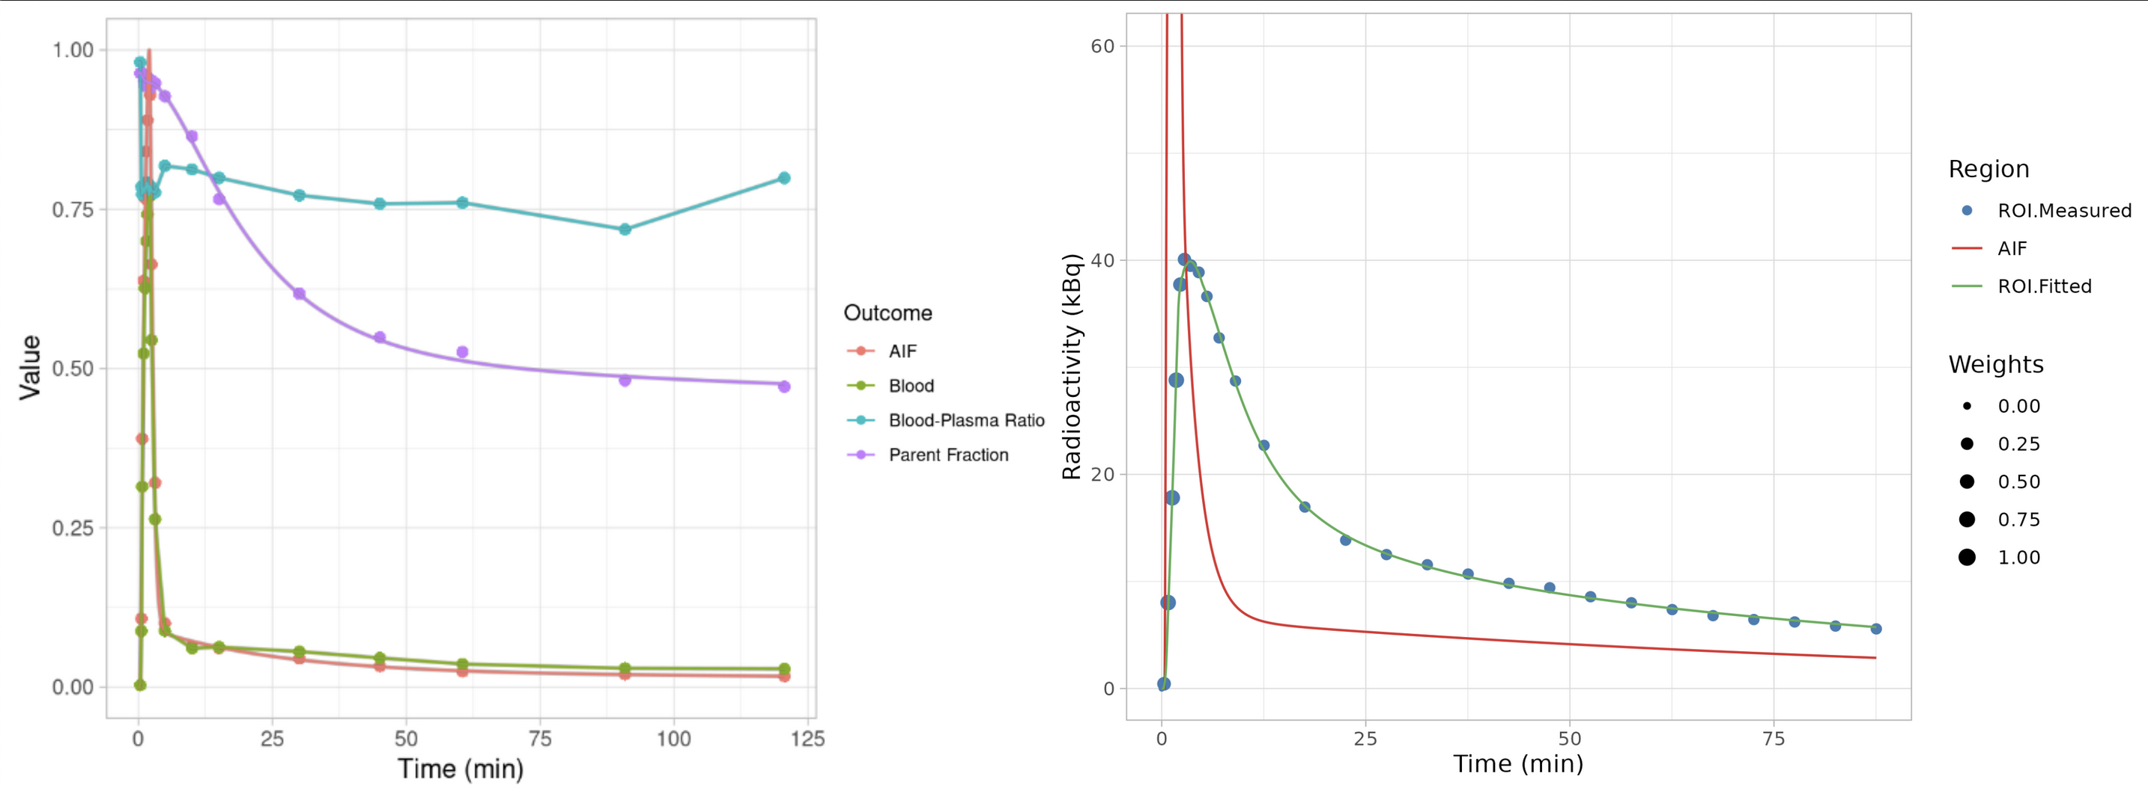
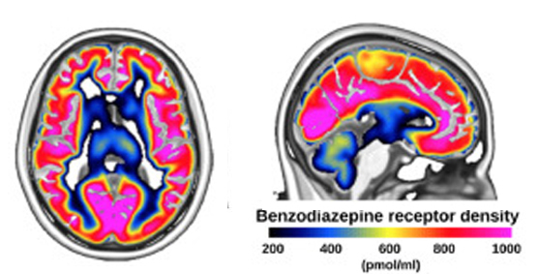
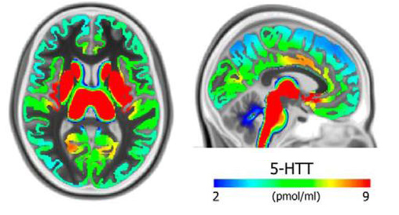


Open Neuro PET : opening PET data workflows
https://openneuropet.github.io/
Cyril Pernet¹ , Anthony Galassi², Martin Norgaard^{2,3}, Granville J. Matheson^{4,5}, Paul Wighton⁶, Adam G. Thomas², Gabriel Gonzalez-Escamilla⁷, Cyrus Eierud⁸, Murat Bilgel⁹, Eric Ceballos¹⁰, Claus Svarer¹, Chris Rorden¹¹, Vince Calhoun⁸, Douglas Greve⁶, Russell Poldrack¹², Melanie Ganz^{1,3}, Robert B. Innis² & Gitte M. Knudsen¹
¹ Neurobiology Research Unit, Copenhagen, Denmark ² NIH, Bethesda, USA ³ Dpt of Computer Science, University of Copenhagen ⁴ Dpt of Clinical Neuroscience, Karolinska Institutet, Stockholm, Sweden ⁵ Mailman school of Public Health, Columbia University, NY, USA ⁶ Martinos Centre, MGH, USA ⁷ University Medical Center of the Johannes Gutenberg University Mainz, Germany ⁸ TReNDS Center, Georgia State University, Atlanta, USA ⁹ National Institute on Aging Intramural Research Program, Baltimore, USA ¹⁰ McGill University, Canada ¹¹ Dpt of Psychology, University of South Carolina, USA ¹² Dpt of Psychology, Stanford University, USA.
Abstract: Reproducibility is a cornerstone of science, and one factor contributing to improving reproducibility is openness, from raw data to publication. OpenNeuroPET (ONP) is a project primarily driven by NIMH (Prof Innis) and the NRU (Prof Knudsen) to develop standardized tools that facilitate seamless conversion and processing of Positron Emission Tomography (PET) data from raw to publication-ready format. ONP also provides a data sharing base where researchers can access PET datasets as well as group templates in the form of molecular atlases.
Data Standard
BIDS specification (raw and derivatives)
PET2BIDS (conversion tool) https://github.com/openneuropet/PET2BIDS
Reporting and publication
https://bids.neuroimaging.io
Data Sharing
OpenNeuro for open-access to PET datasets
PublicNeuro for GPDR-conform access to data
(open metadata but controlled access)
https://publicneuro.eu
https://openneuro.org
Data Workflows
PETSurfer and PETprep for preprocessing of PET-BIDS data
bloodstream + kinfitr for
blood processing and kinetic modelling
GIFT ICA Toolbox for
data-driven PET templates
Molecular Atlases
Build and share templates of receptor availability, metabolism,
and enzymatic activity
Funding
GABA_{A}
5-HTT

